Slide 1


CIS 467 :Data Mining
Department of Information Systems
Faculty of Information Technology and Computer Sciences
Yarmouk University – Jordan
Prof. Dr. Qasem Al-Radaideh
© Qasem Al-Radaideh
Notes:
1

Slide 2
Topic 6 Cluster Analysis Part 1
Introduction
Main Source: J. Han Book
Data Mining: Concepts and Techniques (3nd ed.)
(Chapter 10)
2
Notes:
2

Slide 3
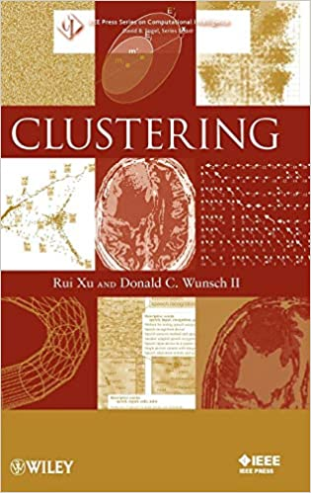
Outline
What is Cluster Analysis?
A Categorization of Major Clustering Methods
Partitioning Methods
The K-Means Algorithm for Data Clustering (P2)
Illustration with full example (P3)
Outlier Analysis (P4)
Using a tool for Data Clustering (P5)

Slide 4
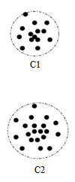
Clustering
Clustering is the process of grouping the data into classes or clusters, so that objects within a cluster have high similarity in comparison to one another but are very dissimilar to objects in other clusters.
Dissimilarities are assessed based on the attribute values describing the objects. Often, distance measures are used. (Do you remember KNN?)
Clustering has its roots in many areas, including data mining, statistics, biology, and machine learning.

Slide 5
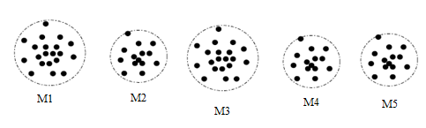
Motivating Example
Imagine that you are the Director of Customer Relationships at AllElectronics, and you have five managers working for you. You would like to organize all the company’s customers into five groups so that each group can be assigned to a different manager. Strategically, you would like that the customers in each group are as similar as possible.
Moreover, two given customers having very different business patterns should not be placed in the same group. Your intention behind this business strategy is to develop customer relationship campaigns that specifically target each group, based on common features shared by the customers per group.
What kind of data mining techniques can help you to accomplish this task?

Slide 6
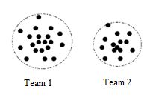
Think
How we can form two teams from the students in this section to participate in a programming competition?
What kind of data mining techniques can help you to accomplish this task?

Slide 7
What is Cluster Analysis?
Cluster: a collection of data objects
Similar to one another within the same cluster
Dissimilar to the objects in other clusters
Cluster analysis
Finding similarities between data according to the characteristics found in the data and grouping similar data objects into clusters
Unsupervised learning: no predefined classes
Typical applications
As a stand-alone tool to get insight into data distribution
As a preprocessing step for other algorithms

Slide 8
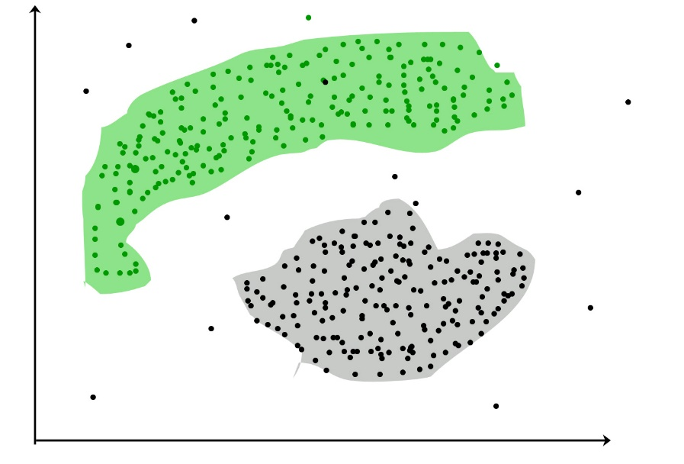
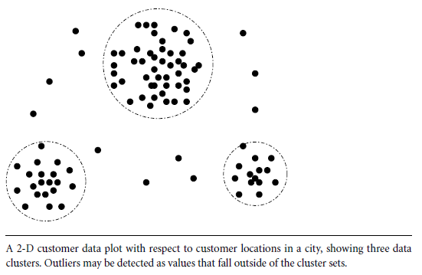
Cluster Analysis
Group data to form new categories (i.e., clusters),
Example: cluster houses to find distribution patterns
Principle: Maximizing intra-class similarity & minimizing inter-class similarity
Many methods and applications
Cluster

Slide 9
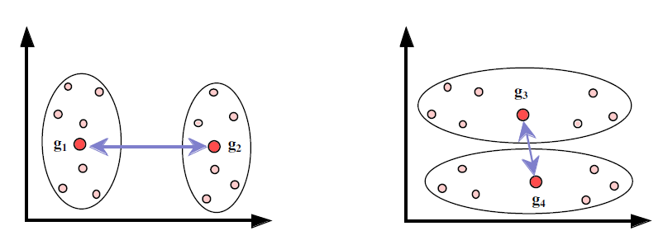
Quality: What Is Good Clustering?
A good clustering method will produce high quality clusters with
high intra-class similarity
low inter-class similarity
The quality of a clustering result depends on both the similarity measure used by the method and its implementation
The quality of a clustering method is also measured by its ability to discover some or all of the hidden patterns

Slide 10
Measure the Quality of Clustering
Dissimilarity/Similarity metric: Similarity is expressed in terms of a distance function, typically metric: d(i, j)
There is a separate “quality” function that measures the “goodness” of a cluster.
The definitions of distance functions are usually very different for interval-scaled, boolean, categorical, ordinal ratio, and vector variables.
Weights should be associated with different variables based on applications and data semantics.
It is hard to define “similar enough” or “good enough”
the answer is typically highly subjective.

Slide 11
Similarity and Dissimilarity Between Objects
Distances are normally used to measure the similarity or dissimilarity between two data objects
Some popular ones include: Minkowski distance:
where i = (x_{i1}, x_{i2}, …, x_{ip}) and j = (x_{j1}, x_{j2}, …, x_{jp}) are two p-dimensional data objects, and q is a positive integer
If q = 1, d is Manhattan distance

Slide 12
Similarity and Dissimilarity Between Objects (Cont.)
If q = 2, d is Euclidean distance:
Properties
d(i,j) ≥ 0
d(i,i) = 0
d(i,j) = d(j,i)
d(i,j) ≤ d(i,k) + d(k,j)
Also, one can use weighted distance, parametric Pearson product moment correlation, or other disimilarity measures

Slide 13
Examples of Euclidean Distances
Euclidean
Dist (x,y) = sqrt (4²+3²) = 5
y = (9,8)
3
5
Manhattan
Dist (x,y) = 4+3 = 7
4
x = (5,5)

Slide 14
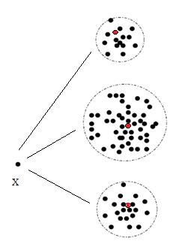
Notes about Clustering Algorithms
A clustering algorithm attempts to find natural groups of components (or data) based on some similarity. Also, the clustering algorithm finds the centroid of a group of data sets.
To determine cluster membership, most algorithms evaluate the distance between a point and the cluster centroids.
The output from a clustering algorithm is basically a statistical description of the cluster centroids with the number of components in each cluster.

Slide 15
Major Clustering Approaches
Partitioning approach:
Construct various partitions and then evaluate them by some criterion, e.g., minimizing the sum of square errors
Typical methods: k-means, k-medoids, CLARANS
Hierarchical approach:
Create a hierarchical decomposition of the set of data (or objects) using some criterion
Typical methods: Diana, Agnes, BIRCH, ROCK, CAMELEON

Slide 16
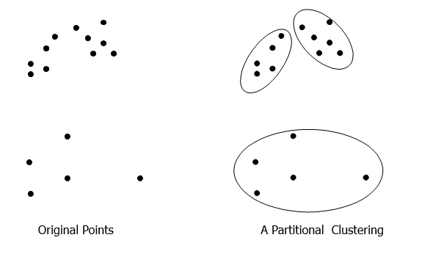
Partitional Clustering

Slide 17
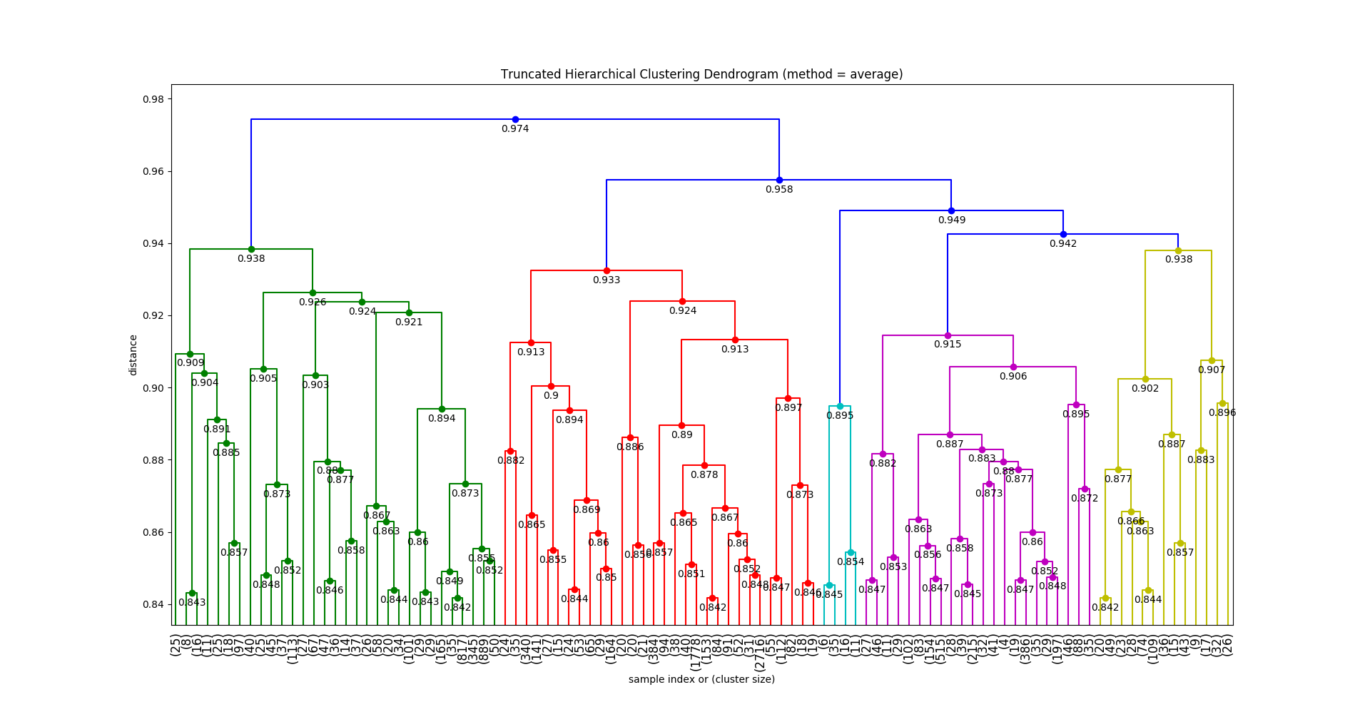
Hierarchical Clustering

Slide 18
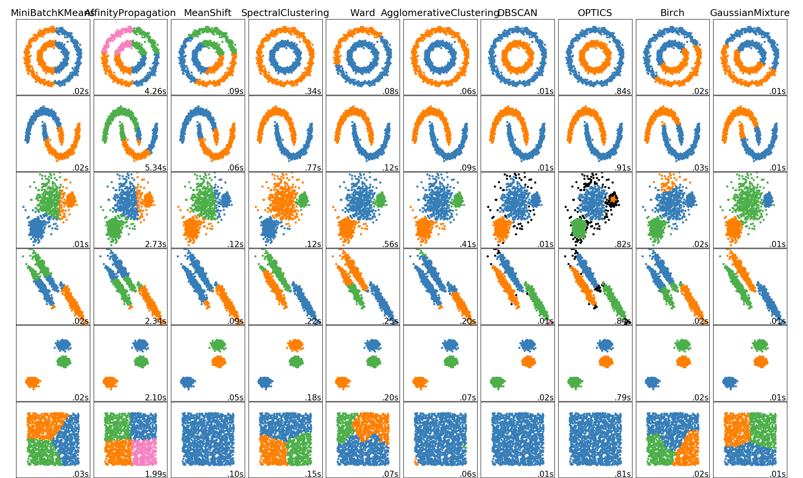
Example of Clustering Visualization

Slide 19
Partitioning Algorithms: Basic Concept
Partitioning method: Construct a partition of a database D of n objects into a set of k clusters.
Given a k, find a partition of k clusters that optimizes the chosen partitioning criterion
Heuristic methods: k-means and k-medoids algorithms
k-means (MacQueen’67): Each cluster is represented by the center of the cluster
k-medoids or PAM (Partition around medoids) (Kaufman & Rousseeuw’87): Each cluster is represented by one of the objects in the cluster

Slide 20
Clustering: Rich Applications and Multidisciplinary Efforts
Pattern Recognition
Spatial Data Analysis
Create thematic maps in GIS by clustering feature spaces
Detect spatial clusters or for other spatial mining tasks
Image Processing
Economic Science (especially market research)
WWW
Document classification
Cluster Weblog data to discover groups of similar access patterns

Slide 21
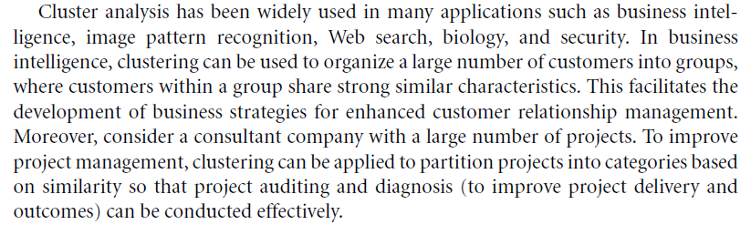
Where we can use Clustering (1)

Slide 22
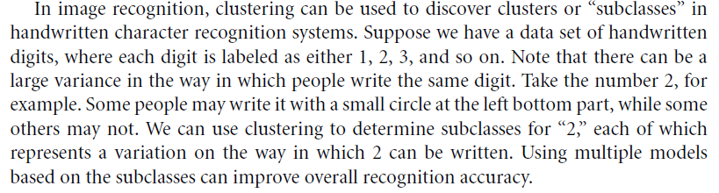
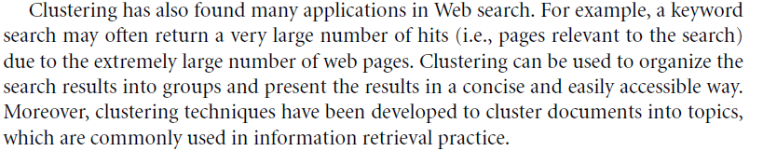
Where we can use Clustering (2)

Slide 23
Other Examples of Clustering Applications
Marketing: Help marketers discover distinct groups in their customer bases, and then use this knowledge to develop targeted marketing programs
Land use: Identification of areas of similar land use in an earth observation database
Insurance: Identifying groups of motor insurance policy holders with a high average claim cost
City-planning: Identifying groups of houses according to their house type, value, and geographical location
Earth-quake studies: Observed earth quake epicenters should be clustered along continent faults

Slide 24

Break حزيرة 3

Slide 25
Summary
Cluster analysis groups objects based on their similarity and has wide applications
Measure of similarity can be computed for various types of data
Clustering algorithms can be categorized into partitioning methods, hierarchical methods, density-based methods, grid-based methods, and model-based methods
There are still lots of research issues on cluster analysis

Slide 26


End … Thanks
Dr. Qasem Al-Radaideh
Yarmouk University

